Slide 1
Comprehensive yet Practical Approach to Falls Prevention
Dr. Frank Molnar
Medical Director,
Regional Geriatric Program of Eastern Ontario ( www.rgpeo.com )
Ottawa Geriatric Assessment Outreach Teams (GAOT)
Champlain Geriatric Emergency Management (GEM) Program
Specialist in Geriatric Medicine
The Ottawa Hospital
Bruyere Continuing Care

Slide 2
Disclosure
I have no actual, potential or perceived commercial conflicts of interest with respect to this topic
I do not accept support from industry
I am affiliated with the three free open access non-commercial education resources promoted in this module but have no personal gain in promoting these resources:
Editor-in-chief of the Canadian Geriatrics Society CME Journal - www.geriatricsjournal.ca
Contributor to www.stopfalls.ca
Contributor to www.posturalhypotension.ca

Slide 3
Acknowledge support of
The Champlain Local Health Integration Network (LHIN)
Champlain Fall Prevention Steering Committee
Ottawa Public Health Unit
Eastern Ontario Health Unit
University of Ottawa, Office of Continuing Professional Development
Regional Geriatric Program of Eastern Ontario

Slide 4
FALLS within the context of The GERIATRIC 5Ms
The Geriatric 5Ms are employed internationally to describe the areas of core expertise of the Multidisciplinary Teams that include specialists in Geriatric Medicine and Care of the Elderly Physicians.
Of the Geriatric 5Ms, MOBILITY is the most clearly related to Falls Prevention.
To understand how some of the other Geriatric 5Ms contribute to Falls Prevention let us look at them in greater detail.
MOBILITY
MIND
MEDICATIONS
MULTI-
COMPLEXITY
MATTERS
MOST
© Frank Molnar & Allen Huang, University of Ottawa;
Mary Tinetti, Yale University

Slide 5
GERIATRIC 5ms©
WHEN GERIATRIC MEDICINE CAN HELP YOU AND YOUR PATIENTS
MIND
Mentation
MOBILITY
Dementia
Delirium
Depression
Impaired gait and balance
Fall injury prevention
MEDICATIONS
Polypharmacy
De-prescribing
Optimal prescribing
Adverse medication effects and medication burden
MULTI-COMPLEXITY
Multi-morbidity
Complex bio-psycho-social situation
MATTERS MOST
Each individual’s own meaningful health outcome goals and care preferences (Goals of Care)
Multiple interacting diseases
MOBILITY
MIND
MEDICATIONS
MULTI-
COMPLEXITY
MATTERS
MOST
© Frank Molnar & Allen Huang, University of Ottawa; Mary Tinetti, Yale University
Notes:
NOTE:
To change the image on this slide, select the picture and delete it. Then click the Pictures icon in the placeholder to insert your own image.

Slide 6
Other Geriatric 5Ms that are relevant to Falls
MIND – cognitive impairment can contribute to falls and also mandates a more tailored individualized approach to Falls Prevention (as employed in Geriatric Day Hospitals).
MEDICATIONS – This presentation will highlight medications that can cause falls and those that can help with Fall Prevention
MULTI-COMPLEXITY – the multiple interacting medical conditions, social and environmental issues (Bio-psychosocial model) that can contribute to falls or that may serve as parts of a strategy to prevent falls will be reviewed.
MOBILITY
MIND
MEDICATIONS
MULTI-
COMPLEXITY
MATTERS
MOST
© Frank Molnar & Allen Huang, University of Ottawa;
Mary Tinetti, Yale University

Slide 7
Learning objectives
Lesson 1 - Background
Describe the importance of the Falls Prevention
Incidence
Impact
Opportunity - Near Falls, Vital sign concept
Lesson 2 - Screening for Fall Risk
Lesson 3 - Basic Assessment every patient with falls or near falls should have
Screen and clinically assess patients for the 3PS
Postural Hypotension
Pills
Pain
Lesson 4 - More in-depth Assessment of patients with falls or near falls
Assessing beyond the 3Ps and/or Referral to Specialized Geriatric Services

Slide 8
Lesson 1: Background
To better understand the human cost of falls
To better understand the economic impact of falls
To appreciate the critical importance of near falls
1.
LEARNING OBJECTIVES:
2.
3.

Slide 9
Falls are extremely costly in human terms and in health care utilization
FALLS are THE leading cause of injury for seniors.
1/3 of all seniors fall every year – the physical and psychological consequences are often devastating including disability, chronic pain, loss of independence, depression, reduced quality of life and death (8% of fall-related hospitalizations end in death) .
235,355 ED visits and 84,828 fall-related hospitalizations in Canada in 2012-13
FALLS are costing the Health Care System BILLIONS of dollars
The annual cost for treating hip fractures in Canada is $1.1 billion.
- Nikitovic, M., et al
Direct care costs of falls are $2 Billion per year – Canada
- Preventing Falls: From Evidence to Improvement in Canadian Health Care 2014, Accreditation Canada
Total economic burden of falls per year (Direct costs for health care + Indirect costs to patients their family and the economy) is $6 Billion

Slide 10
The Good News !!!
The literature suggests that as many as 1/3 of falls-related adverse outcomes are preventable
Division of Aging and Seniors 2006
Opportunity-The Vital Sign concept & Near Falls
The sudden onset of falls or near falls in someone who previously did not have a falling tendency most likely represents new or worsening underlying illness and / or the side effects of a new medication or changing doses of medications.

Slide 11
Champlain Falls Strategy How were tools developed
In 2013 the Champlain (eastern Ontario) LHIN Funded regional Falls Strategy developed a falls algorithm based on American and British Geriatric Society Clinical Practice Guidelines. The approach you will see is more detailed than that employed by the AGS/BGS and prioritized items that are more common and more reversible
A Primary Care - Specialist Care Collaboration: Tested in Primary Care and refined with Primary Care based on feedback
Adopted a standardized validated self screening tool “Staying Independent Checklist” to complement the algorithm - can be completed by seniors and family members in physician’s offices and/or in the community.

Slide 12
Lesson 2: Screening for Fall Risk
To better understand when and how to screen for Fall Risk
To become familiar with the Staying Independent Checklist
To become familiar with published standardized balance and mobility assessment tools
Identify and support recommendations for bone health and fall prevention
1.
2.
LEARNING OBJECTIVES:
3.
4.

Slide 13
Screening for Fall Risk
All older adults should be asked at least once a year about falls, frequency of falling and difficulties in gait or balance. (AGS/BGS guidelines January 2011 – Vol 59, p149.)
A fall in the previous year is the strongest predictor for a future fall (Delbaere, et al. 2008; ICSI 2010;)
Do NOT forget to ask about NEAR FALLS
This is the optimal time to intervene
NEAR FALLS
FALLS?
MOBILITY

Slide 14
Champlain Falls Prevention Strategy:
Stay on Your Feet ® Screening Algorithm
= Community Health Agencies
= Primary Care Providers
= Specialized or Tertiary Care Providers
All adults 65+ should be screened for falls on an annual basis in community programs or with a Primary Care Practitioner. Consider a self-screening tool: “Staying Independent Checklist” *
Screen for fall(s) or near falls:
Two or more falls or near falls in past year
Primary Care Assessment/Interventions
Obtain relevant medical history, history of falls, physical examination, including cognitive and functional assessment to identify root cause.
Determine multifactorial fall risk by assessing: (see Guide on reverse) including:
Visual acuity
Other neurological impairments and refer appropriately
Bone health; assess calcium intake, fracture risk and nutritional review. Supplement vitamin D. Consider calcium & BMD testing. Treat as per www.osteoporosis.ca guidelines.
Feet and footwear
Environmental hazards: You Can Prevent Falls (Public Health) at www.stopfalls.ca
i. Depression & Behavioural Risk Factors i.e.: ETOH.
Fall with injury
Difficulty with walking or balance
Score of 4 or more on Staying Independent Checklist
Postural hypotension - suggest lying and standing BP
(www.posturalhypotension.ca)
Pills/medication: minimize meds contributing to falls and consider pharmacy consult; optimize pain management
Pain, gait, balance, mobility and muscle strength (i.e.: TUG or other tests). Evaluate pain-related mobility: and/or need for mobility aids
Yes to any one of the screening questions?
Obtain fall history
Evaluate gait and use of aids if difficulty or change in walking
Is recurrence of fall likely?
YES
Postural hypotension- • suggest lying and standing BP See www.posturalhypotension.ca
Pills/medication: minimize meds contributing to falls and consider pharmacy consult; optimize pain management
Pain, gait, balance, mobility and muscle strength (ie
NO
Single fall in past year or several near falls?
YES
Evaluate Gait: Abnormalities noted? Yes/No
YES
NO
NO
Health Promotion Key Messages:
Encourage regular periodic health visit; annual medication, alcohol review and eye exam
Complete a home safety checklist annually
150 minutes of physical activity per week – consider Champlain Exercise Programs: Champlainhealthline.ca
Muscle and bone strengthening exercises to improve balance
Eat 3 or more servings of calcium rich foods daily
Take a daily vitamin D supplement
REFER
If appropriate, refer to specialized Geriatric services and/ or community programs. See www.rgpeo.com.
See referral and resource list at stopfalls.ca
AGS & BGS Guideline: http://www.americangeriatrics.org/health_care_professionals/clinical_practice/clinical_guidelines_recommendations/prevention_of_falls_summary_of_recommendations/ ;RNAO (2017) Prevention of Fall & Fall Injuries in Older Adults; https://rnao.ca/news/updated-bpg-preventing-falls-and-reducing-injury-falls *Staying Independent Checklist available online at (www.stopfalls.ca ). Health Canada http://hc-sc.gc.ca/fn-an/food-guide-aliment/index-eng.php; Document reviewed / revised 2018

Slide 15
RESOURCES
www.stopfalls.ca
Staying Independent Checklist
Algorithm
Links to many useful resources

Slide 16
Screening Tool “Staying Independent Checklist”
Developed by VA hospitals in US, used broadly in BC.
Validated and standardized.
Useful as a self-screening tool
Can be completed by patients alone or with help of family in your waiting room, in their home or in other community settings

Slide 17
Staying
Independent
Checklist

Slide 18
Gait, balance, and mobility TESTS
Get Up and Go
Timed Up and Go
The above tests take a few minutes to set up but once set up can be used for an unlimited number of patients and only takes seconds
30 second Chair Stand Test
If office not set up for above walking tests

Slide 19
Get Up and Go
Place a straight-back chair 3 meters from and facing a wall (preferably a chair that does not have a seat which slants back)
Ask senior to rise from chair, without using arms for support & stand still for a moment
Walk towards the wall
Turn without touching the wall & walk back to the chair & sit down

Slide 20
GET UP AND GO CHECK LIST
Maneuver
Normal
Mild Abnormalities
Mod/Severely Abnormal
Rising from chair
No slowness (< 4sec) or hesitancy
Uses assist to begin rising
Uses assist throughout rising, leans forward
Standing
No signs of instability
Wide stance, irregular posture
Severe trunk sway (5-10 degrees), reaches out hand to balance, staggers
Turning
No hesitation, takes 2-3 foot placements to turn
Slowness, hesitation, 4-5 foot placements to turn
More than 6 foot placements to turn or cannot safely execute turn, staggers
Sitting down
Smooth decent, does not use chair for support
Slow descent, hesitates or pauses during descent
Uses chair to sit, does not control descent, nearly misses chair

Slide 21
TUG Timed Up and GO Test
Uses standard chair w armrests (46cm seat height and 63-65cm armrest height)
Tape Measure and marker for distance
3m path free of obstruction
Stop watch (Smart Phone)
One practice trial is permitted
Senior wears their regular footwear and uses their regular walking aids. No physical assistance is given.
Senior to get up out of chair, walk 3 meters, turn around, return and sit down
Instructions at www.stopfalls.ca

Slide 22
TUG scoring
Healthy individuals between the ages of 60-80 years complete the TUG in 10 seconds or less.
Steffen, Hacker and Mollinger (2002)
Standardized cut-off scores to predict risk of falling
A cut-off score of ≥ 13.5 seconds was shown to predict falling
in community-dwelling frail elders
Shumway-Cook et al. (2000).
TUG score for risk of falls is not valid with Cognitive Impairment
Persons with cognitive impairment and falls (“Forgetful Fallers”) likely need referral to Specialized Geriatric Services

Slide 23
The 30-second Chair Stand Test
Purpose: To assess leg strength and endurance.
Equipment:
A chair with a straight back without arm rests (seat 17” high)
A stopwatch (smart phone)
Instructions to the patient:
1. Sit in the middle of the chair.
2. Place your hands on the opposite shoulder crossed at the wrists.
3. Keep your feet flat on the floor.
4. Keep your back straight.
5. On “Go”, rise to a full standing position and then sit back down again.
6. Repeat this for 30 seconds.
On “Go”, begin timing.
Count the number of times the patient comes to a full standing position in 30 seconds.
If the patient is over halfway to a standing position when 30 seconds have elapsed, count it as a stand.
Record the number of times the patient stands in 30 seconds.

Slide 24
The 30-second Chair Stand Test
Below Average Scores in seconds
AGE | MEN | WOMEN
60-64 | < 14 | < 12
65-69 | < 12 | < 11
70-74 | < 12 | < 10
75-79 | < 11 | < 10
80-84 | < 10 | < 9
85-89 | < 8 | < 8
90-94 | < 7 | < 4
A below average rating indicates a high risk for falls.

Slide 25
Lesson 3: Basic Assessment that every faller/near faller should have - 3Ps
To follow the Champlain Fall Prevention Algorithm regarding basic assessment of Falls - 3Ps (Postural Hypotension, Pills, Pain & Mobility)
To learn the Differential Diagnosis of Postural Hypotension
To enhance awareness of medications that potentially contribute to falls
1.
LEARNING OBJECTIVES:
2.
3.

Slide 26
Champlain Falls Prevention Strategy:
Stay on Your Feet ® Screening Algorithm
= Community Health Agencies
= Primary Care Providers
= Specialized or Tertiary Care Providers
All adults 65+ should be screened for falls on an annual basis in community programs or with a Primary Care Practitioner. Consider a self-screening tool: “Staying Independent Checklist” *
Screen for fall(s) or near falls:
Two or more falls or near falls in past year
Primary Care Assessment/Interventions
Obtain relevant medical history, history of falls, physical examination, including cognitive and functional assessment to identify root cause.
Determine multifactorial fall risk by assessing: (see Guide on reverse) including:
Visual acuity
Other neurological impairments and refer appropriately
Bone health; assess calcium intake, fracture risk and nutritional review. Supplement vitamin D. Consider calcium & BMD testing. Treat as per www.osteoporosis.ca guidelines.
Feet and footwear
Environmental hazards: You Can Prevent Falls (Public Health) at www.stopfalls.ca
i. Depression & Behavioural Risk Factors i.e.: ETOH.
Fall with injury
Difficulty with walking or balance
Score of 4 or more on Staying Independent Checklist
1
Postural hypotension - suggest lying and standing BP
(www.posturalhypotension.ca)
Pills/medication: minimize meds contributing to falls and consider pharmacy consult; optimize pain management
Pain, gait, balance, mobility and muscle strength (i.e.: TUG or other tests). Evaluate pain-related mobility: and/or need for mobility aids
2
Yes to any one of the screening questions?
Obtain fall history
Evaluate gait and use of aids if difficulty or change in walking
Is recurrence of fall likely?
YES
Postural hypotension- • suggest lying and standing BP See www.posturalhypotension.ca
Pills/medication: minimize meds contributing to falls and consider pharmacy consult; optimize pain management
Pain, gait, balance, mobility and muscle strength (ie
NO
Single fall in past year or several near falls?
YES
Evaluate Gait: Abnormalities noted? Yes/No
YES
NO
NO
Health Promotion Key Messages:
Encourage regular periodic health visit; annual medication, alcohol review and eye exam
Complete a home safety checklist annually
150 minutes of physical activity per week – consider Champlain Exercise Programs: Champlainhealthline.ca
Muscle and bone strengthening exercises to improve balance
Eat 3 or more servings of calcium rich foods daily
Take a daily vitamin D supplement
REFER
If appropriate, refer to specialized Geriatric services and/ or community programs. See www.rgpeo.com.
See referral and resource list at stopfalls.ca
AGS & BGS Guideline: http://www.americangeriatrics.org/health_care_professionals/clinical_practice/clinical_guidelines_recommendations/prevention_of_falls_summary_of_recommendations/ ;RNAO (2017) Prevention of Fall & Fall Injuries in Older Adults; https://rnao.ca/news/updated-bpg-preventing-falls-and-reducing-injury-falls *Staying Independent Checklist available online at (www.stopfalls.ca ). Health Canada http://hc-sc.gc.ca/fn-an/food-guide-aliment/index-eng.php; Document reviewed / revised 2018

Slide 27
Building a solid Foundation
History and/or description of the falls and current functioning will help with the Differential Diagnosis.
Screening of cognition may indicate cognitive issues that confound assessment and prevention of falls.
Sometimes this allows you to move to a specific work up (e.g. vertigo, syncope) without working through this algorithm
“Forgetful Fallers” consider referral to Specialized Geriatric Services (e.g. Geriatric Outreach and then on to a Geriatric Day Hospitals).

Slide 28
Part 2: the 3 Ps
1. Obtain relevant medical history, history of falls, physical examination, including cognitive and functional assessment to identify root cause.
2. Determine multifactorial fall risk by assessing: (see assessment checklist on reverse)
Postural hypotension
- Heart rate and rhythm
Pills/Medication: minimize meds contributing to falls and consider pharmacy consult; optimize pain management
Pain, gait, balance, mobility and muscle strength (i.e. TUG or other tests). Evaluate pain-related mobility: consider referral for appropriate mobility aids OTHER FACTORS
Visual acuity
Other neurological impairments and refer appropriately
Bone health; assess calcium intake and fracture risk; nutritional review. Supplement vitamin D and consider calcium; if ongoing fall risk - consider bone density and treat if OP or history of fragility fractures then treat
Feet and footwear;
Environmental hazards: consider home hazard checklist at stopfalls.ca
Depression and Behavioural Risk Factors i.e. ETOH.

Slide 29
Assessment - 2a: Postural Hypotension
New onset neurological symptoms 1-3 min after sitting or standing
Lightheadedness, perspiration, nausea, weakness, dizziness, headache, vision changes
Measure BP and Pulse after the person has been lying for at least 3-5 minutes and 1 and 3 minutes after standing
American Academy of Neurology definition: A decline of >20 mm Hg in systolic BP and/or >10 mm Hg in diastolic BP on the assumption of an upright posture with or without an increase in PR
Go to www.posturalhypotension.ca

Slide 30
4D-AID: A PRACTICAL APPROACH TO THE ASSESSMENT OF THE ORTHOSTATIC HYPOTENSION IN OLDER PATIENTS
www.geriatricsjournal.ca - or www.posturalhypotension.ca

Slide 31
Assessment - 2a. Postural Hypotension 4D-AID acronym
I. Causes associated with a compensatory tachycardia – 4Ds
Deconditioning
Dysfunctional Heart
Myocardium (very low Left Ventricular Ejection Fraction)
Aortic Stenosis
Dehydration
Disease
Dialysis (post dialysis dry weight too low)
Drugs
Diuretics
Anorexic Drugs – narcotics, digoxin, antibiotics, cholinesterase inhibitors
www.posturalhypotension.ca

Slide 32
Assessment - 2a. Postural Hypotension 4D-AID acronym
I. Causes associated with a compensatory tachycardia – 4Ds … continued
Drugs – 6 ANTIs
Anti-hypertensives
Anti-anginals
Anti-parkinsonian medications (e.g. Sinemet)
Anti-depressants (e.g., Anti-cholinergic tricyclics)
Anti-psychotics (Anti-cholinergic effect)
Anti-BPH (e.g. Hytrin, Flomax)
www.posturalhypotension.ca

Slide 33
Assessment - 2a. Postural Hypotension 4D-AID acronym
II. Causes that present with lack of compensatory tachycardia - AID
Autonomic Dysfunction
Diabetic autonomic neuropathy (consider if patient has peripheral neuropathy)
Low B12
Hypothyroidism
ETOH abuse
Parkinsonism (Parkinson’s disease, Progressive Supranuclear Palsy, Multisystem Atrophy (e.g. Shy Drager))
Idiopathic (Bradbury-Eggleston)
Depletion of Norepinephrine from sympathetic nerve terminals
Drugs
Beta-Blockers
www.posturalhypotension.ca

Slide 34
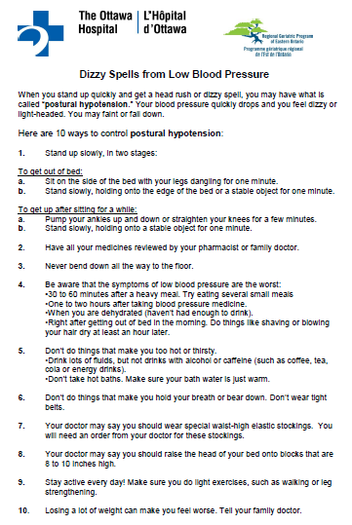
Non- pharmaceutical treatment of Hypotension - handouts for patients are available on www.stopfalls.ca www.posturalhypotension.ca

Slide 35
HYPERTENSION
www.geriatricsjournal.ca

Slide 36
Assessment - 2a: Heart rate / rhythm + blood flow
Decreased Cardiac Output
I. Persistantly low BP
Very low Left Ventricular Ejection Fraction (e.g. <20% Severe MR with backward flow will lower forward LVEF)
Blockage of blood flow
Valvular
aortic or mitral stenosis
Subaortic stenosis
Aortic dissection
Pulmonary Embolus

Slide 37
Assessment - 2a: Heart rate / rhythm + blood flow
Decreased Cardiac Output
II. Intermittently low BP
1. Arrhythmia
Tachycardia (inadequate time in diastole for heart to fill): VT, SVT, WPW, VF, AFIB …
Bradycardia; SSS, conduction blocks (complete heart block)
Can be precipitated by digoxin, beta-blocker (including Timoptic /Timolol eye drops), Cholinesterase Inhibitors, Ca Channel Blockers
Carotid Sinus Hypersensitivity

Slide 38
Heart rate / rhythm + blood flow
VASOVAGAL - Syncope Triggered by: increased firing of vagus nerve and slowing heart rate - thereby decreasing blood pressure
Stress
Any painful or unpleasant stimuli, such as:
Venipuncture
Hitting your funny bone
Experiencing medical procedures with local anesthesia
Post-surgical pain when standing up or moving too abruptly after the procedure
Giving or receiving a needle immunization
Watching someone give blood
Watching someone experience pain
Watching or experiencing medical procedures
Sight of blood
Occasions of slight discomfort, such as dental and eye examinations

Slide 39
Heart rate / rhythm + blood flow
VASOVAGAL - Syncope Triggered by: increased firing of vagus nerve and slowing heart rate - thereby decreasing blood pressure
Stress
Sudden onset of extreme emotions
Nausea or vomiting
Urination ('micturition syncope') or defecation, having a bowel movement ('defecation syncope')
Abdominal straining or 'bearing down'
Swallowing ('swallowing syncope') or coughing ('cough syncope')
Pressing upon certain places on the throat, sinuses, and eyes, also known as vagal reflex stimulation when performed clinically
WARNING: Do not jump to this Dx immediately - consider if Holter or Loop/Event Recorder needed + check Postural BP supine vs. standing

Slide 40
Determine Risk through Multifactoral Assessment Part 2: the 3 Ps
1. Obtain relevant medical history, history of falls, physical examination, including cognitive and functional assessment to identify root cause.
2. Determine multifactorial fall risk by assessing: (see assessment checklist on reverse)
Postural hypotension
- Heart rate and rhythm
Pills/Medication: minimize meds contributing to falls and consider pharmacy consult; optimize pain management
Pain, gait, balance, mobility and muscle strength (i.e. TUG or other tests). Evaluate pain-related mobility: consider referral for appropriate mobility aids
OTHER FACTORS
d. Visual acuity
e. Other neurological impairments and refer appropriately
f. Bone health; assess calcium intake and fracture risk; nutritional review. Supplement vitamin D and consider
calcium; if ongoing fall risk - consider bone density and treat if OP or history of fragility fractures then treat
g. Feet and footwear;
h. Environmental hazards: consider home hazard checklist at stopfalls.ca
i. Depression and Behavioural Risk Factors i.e. ETOH.

Slide 41
Assessment: Pills
Slow reaction time (drugs that cause delirium and slow mentation)
Narcotics, benzodiazepines, ETOH, Anticholinergics (e.g. Ditropan, Detrol, Tricyclic antidepressants ).
Decrease cerebral perfusion (see Postural hypotension – 6 ANTIs
Anti-hypertensives,Anti-anginals,Anti-parkinsonian medications (e.g. sinemet),Anti-depressants (e.g., Anti-cholinergic tricyclics),Anti-psychotics (Anti-cholinergic effect),Anti-BPH (e.g. Hytrin, Flomax)
Cause parkinsonism
Antipsychotics
GI – Stemetil, Maxeran
SSRIs - Evidence that SSRIs increase fall risk
Vestibular Toxicity
Aminoglycosides, High dose loop diretics

Slide 42
Decrease or stop drugs/substances that can cause Delirium
Is the patient on delirium inducing drugs
(Do NOT forget to review ETOH use) :
Benzodiazepines
Narcotics
Alcohol – affects both cognition and balance
Canabis
Antihistamines
Neuroleptics (Antipsychotics)
Haldol, Respiridone, Olanzepine
Anticonvulsants (Seizure medications)
Dilantin (Phenytoin), Gabapentin, Pregabalin
Keep dilantin level at level that previously controlled seizures – if this info not available then try to keep level < 60)
Anticholinergics (see next slides)

Slide 44
How can one sort through this daunting list of medications?
Look for a time-based relationship
Falls or confusion worsened after starting this medication (or increasing the dose).
Ask Pharmacist to review drugs that may be contributing to falls and/or impairing cognition (theoretical perspective) and then apply a practical lens based on personal knowledge of patient to develop a tailored personalized plan for medication adjustments https://canadiangeriatrics.ca/wp-content/uploads/2018/10/5_Frank-Molnar-Article-Formatted-FinalV2.pdf

Slide 45
Polypharmacy www.geriatricsjournal.ca

Slide 46
Determine Risk through Multifactoral Assessment Part 2: the 3 Ps
1. Obtain relevant medical history, history of falls, physical examination, including cognitive and functional assessment to identify root cause.
2. Determine multifactorial fall risk by assessing: (see assessment checklist on reverse)
Postural hypotension
- Heart rate and rhythm
Pills/Medication: minimize meds contributing to falls and consider pharmacy consult; optimize pain management
Pain, gait, balance, mobility and muscle strength (i.e. TUG or other tests). Evaluate pain-related mobility: consider referral for appropriate mobility aids
OTHER FACTORS
d. Visual acuity
e. Other neurological impairments and refer appropriately
f. Bone health; assess calcium intake and fracture risk; nutritional review. Supplement vitamin D and consider
calcium; if ongoing fall risk - consider bone density and treat if OP or history of fragility fractures then treat
g. Feet and footwear;
h. Environmental hazards: consider home hazard checklist at stopfalls.ca
i. Depression and Behavioural Risk Factors i.e. ETOH.

Slide 47
Resources: deprescribing.org
https://deprescribing.org/resources/deprescribing-guidelines-algorithms/
deprescribing algorithms for:
Antipsychotics
Antihyperglycemics
Benzodiazepine receptor agonists
This Photo by Unknown Author is licensed under CC BY-ND

Slide 48
Diabetes / Endocrinology www.geriatricsjournal.ca

Slide 49
Pain, mobility, gait and strength
Optimize Medications for Pain;
1) Tylenol arthritis, long acting 650 mg TID straight
OR
Tylenol Extra Strength; 500 mg q 4 h straight while awake
(Maximum Tylenol dose – 3 grams / 24 hours)
2) Topical Analgesics if 1 or 2 discrete superficial sites of pain
(i.e. Topical Voltaren, topical Lidocaine)
3) NSAIDS if safe;
no heart failure, renal dysfunction, or elevated BP
4) Narcotics if safe;
watch for delirium, anorexia with weight loss, constipation

Slide 50
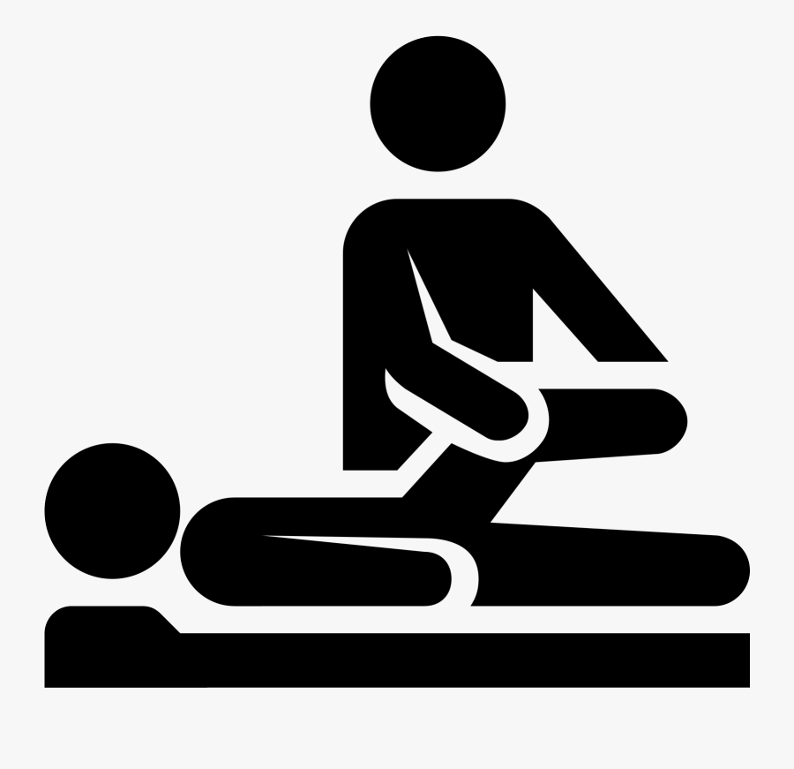
Pain, mobility, gait and strength
Do NOT forget that Physiotherapy and Occupational Therapy can make major contributions to pain control that can allow us to decrease medication use via approaches including but not restricted to:
[1] compensatory strategies,
[2] positioning,
[3] exercise – balance and strengthening,
[4] offloading joints and improving base of support with appropriate mobility aids

Slide 51
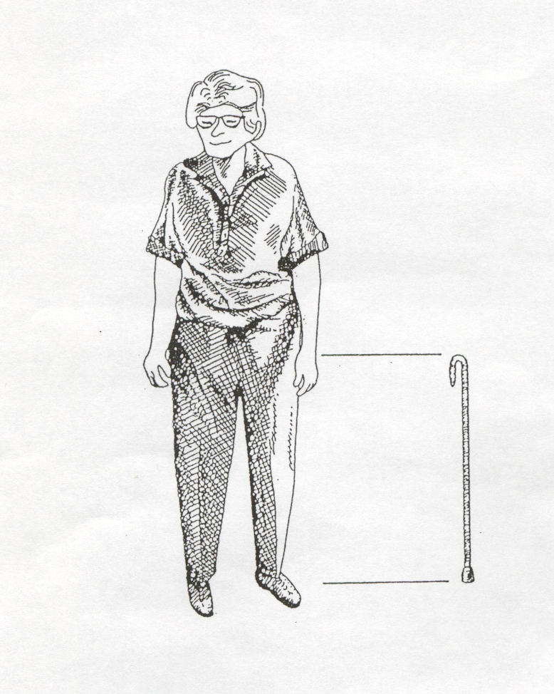
MOBILITY AIDS - Cane
Correct height
Correct use
In good repair
Cane height: wrist crease
If Kyphosis consult Physiotherapy
Does bottom of cane have rubber tip
Are they using the cane on the correct side

Slide 52
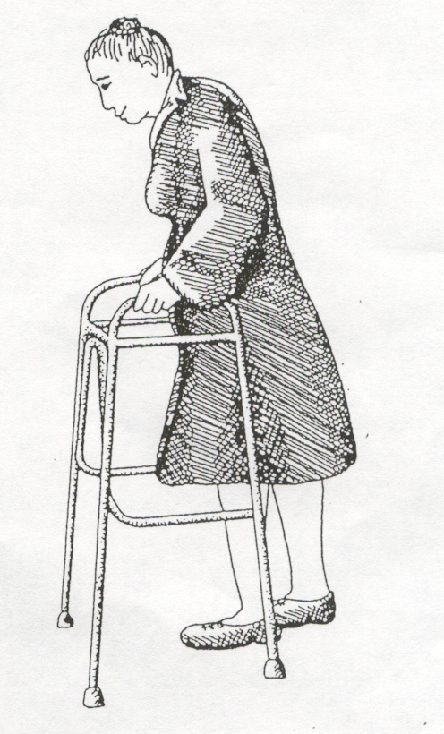
MOBILITY AIDS - Walker
Correct height
Correct use
In good repair
Walker height: 1-2 inches higher than wrist crease
If Kyphosis consult Physiotherapy
Walker seat height: 1-2 inches higher than knee crease

Slide 53
Gait, balance, and mobility TESTS
Consider combined assessment
Get Up and Go
qualitative observation grid
Timed Up and Go
Quantitative measurement of speed
* Once set up, takes very little time to administer
30 second Chair Stand Test
If office not set up for above walking tests

Slide 54
Lesson 4: In-depth Assessment - beyond the 3Ps
To better understand the other causes of falls (beyond Postural Hypotension, Pills and Pain)
To review Public Health and Osteoporosis Canada Bone Health recommendations
To understand when and how to refer to Specialized Geriatric Services
Become aware of resources at www.stopfalls.ca and www.geriatricsjournal.ca
1.
Learning objectives:
2.
3.
4.

Slide 55
Champlain Falls Prevention Strategy:
Stay on Your Feet ® Screening Algorithm
= Community Health Agencies
= Primary Care Providers
= Specialized or Tertiary Care Providers
All adults 65+ should be screened for falls on an annual basis in community programs or with a Primary Care Practitioner. Consider a self-screening tool: “Staying Independent Checklist” *
Screen for fall(s) or near falls:
Two or more falls or near falls in past year
Primary Care Assessment/Interventions
Obtain relevant medical history, history of falls, physical examination, including cognitive and functional assessment to identify root cause.
Determine multifactorial fall risk by assessing: (see Guide on reverse) including:
Visual acuity
Other neurological impairments and refer appropriately
Bone health; assess calcium intake, fracture risk and nutritional review. Supplement vitamin D. Consider calcium & BMD testing. Treat as per www.osteoporosis.ca guidelines.
Feet and footwear
Environmental hazards: You Can Prevent Falls (Public Health) at www.stopfalls.ca
i. Depression & Behavioural Risk Factors i.e.: ETOH.
Fall with injury
Difficulty with walking or balance
Score of 4 or more on Staying Independent Checklist
1
Postural hypotension - suggest lying and standing BP
(www.posturalhypotension.ca)
Pills/medication: minimize meds contributing to falls and consider pharmacy consult; optimize pain management
Pain, gait, balance, mobility and muscle strength (i.e.: TUG or other tests). Evaluate pain-related mobility: and/or need for mobility aids
Yes to any one of the screening questions?
Obtain fall history
Evaluate gait and use of aids if difficulty or change in walking
Is recurrence of fall likely?
YES
Postural hypotension- • suggest lying and standing BP See www.posturalhypotension.ca
Pills/medication: minimize meds contributing to falls and consider pharmacy consult; optimize pain management
Pain, gait, balance, mobility and muscle strength (ie
NO
2
Single fall in past year or several near falls?
YES
Evaluate Gait: Abnormalities noted? Yes/No
YES
3
NO
NO
Health Promotion Key Messages:
Encourage regular periodic health visit; annual medication, alcohol review and eye exam
Complete a home safety checklist annually
150 minutes of physical activity per week – consider Champlain Exercise Programs: Champlainhealthline.ca
Muscle and bone strengthening exercises to improve balance
Eat 3 or more servings of calcium rich foods daily
Take a daily vitamin D supplement
REFER
If appropriate, refer to specialized Geriatric services and/ or community programs. See www.rgpeo.com.
See referral and resource list at stopfalls.ca
AGS & BGS Guideline: http://www.americangeriatrics.org/health_care_professionals/clinical_practice/clinical_guidelines_recommendations/prevention_of_falls_summary_of_recommendations/ ;RNAO (2017) Prevention of Fall & Fall Injuries in Older Adults; https://rnao.ca/news/updated-bpg-preventing-falls-and-reducing-injury-falls *Staying Independent Checklist available online at (www.stopfalls.ca ). Health Canada http://hc-sc.gc.ca/fn-an/food-guide-aliment/index-eng.php; Document reviewed / revised 2018

Slide 56
Assessment – 2d. Visual Acuity
Sudden vision changes with inadequate time to compensate
Cognitive problems interfering with inability to compensate for poor vision.
Severe vision problems beyond ability to compensate
DDX:
Glaucoma (lose peripheral vision – tunnel vision)
Cataracts
Age Related Macular Degeneration (ARMD)
lose central color vision
Sudden change in vision in patient with ARMD is an ophthalmologic emergency – call ophthalmologist ASAP to have them determine if patient has a growing retinal tear and needs laser treatment on an urgent basis.

Slide 57
Assessment - 2e: Other Neurological Impairments (list is illustrative, not exhaustive)
3Ds - Dementia, Delirium, Depression
Apraxia, decreased compensation, slow mentation
Stroke, cerebellar disease, NPH, Seizures
subdural hematoma, subarachnoid bleed (cause and effect of falls)
Spinal stenosis, Myasthenia Gravis, ALS
Myopathy, myositis (not strictly neuro but do not forget)
Peripheral or Autonomic neuropathy
ETOH, DM, B12 …
Parkinsonism (next slide)

Slide 58
Assessment - 2e: Other Neurological Impairments
DDx of Parkinsonism (Parkinson’s Plus) - consider referral to Neurology
Parkinson’s Disease (idiopathic parkinsonism)
TRAP: Resting Tremor, Cogwheel Rigidity, Akinesia / bradikinesia
(slowness), Postural Instability (decreased balance, falls)
Vascular parkinsonism
TRAP, limited to no response to Parkinson's meds, basal ganglia strokes
Drugs (antipsychotics, GI drugs [stemetil, maxeran])
Lewy Body disease (referral to Specialized Geriatric Services)
Dementia, Longstanding Hallucinations, Longstanding Fluctuation
Progressive Supranuclear Palsy (PSP)
Loss of downward gaze and then all eye movements
depression, anxiety, psychosis, dementia
Late Alzheimer’s
Multisystem atrophies (MSA – multiple neurologic symptoms)
Shy-dragger, OPCD, SND etc.

Slide 59
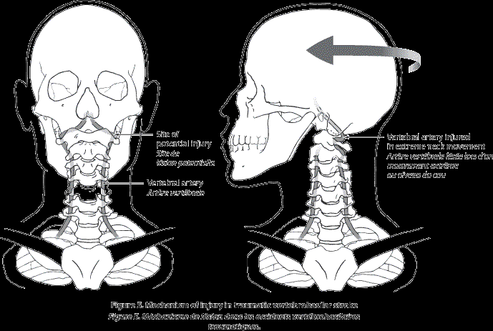
Assessment - 2e: Other Neurological Impairments
Vertebrobasilar Insufficiency
Provoked by head or neck movement
Seconds to minutes
Other brainstem symptoms
Diplopia
Dysarthria
Facial numbness
Ataxia
Reduced vertebral artery flow on doppler or angiography
Treatment:
Behaviour modification

Slide 60
Assessment - 2f: Bone Health; nutritional review
Currently, Ottawa Public Health recommends daily for adults 51 years and older:
3 or more servings of Milk and Alternatives
Adequate amounts of calcium and vitamin D rich foods
A vitamin D supplement of 400 IU
RCTs and meta-analyses have demonstrated a beneficial effect of Vitamin D in fall prevention distinct from its effect on bone health
Possibly via muscle strength and neuromuscular function.
Recommended article; THE ROLE OF VITAMIN D IN BONE METABOLISM AND BEYOND (Martha Spencer, Roger Wong)
www.geriatricsjournal.ca
http://canadiangeriatrics.ca/wp-content/uploads/2016/11/The-Role-of-Vitamin-D-in-Bone-Metabolism-and-Beyond.pdf

Slide 61
Calcium from food and/or supplement:
Women
51-70 yrs : 1200 mg
71yrs + : 1200 mg
Men
51-70 yrs : 1000 mg
71yrs+ : 1200 mg
Vit D from food and supplement, ( ♀ and ♂)
51-70 yrs : 600 IU
71yrs + : 800 IU
Recommendations include a supplement for all adults 50 yrs + of 400 IU
Upper maximum intake: 4000 IU

Slide 62
Bone health and nutrition
Ottawa Public Health; Includes link to resources for seniors.
Osteoporosis Canada - calcium calculator
http://documents.ottawa.ca/sites/documents.ottawa.ca/files/documents/issue_89_en.pdf
http://www.osteoporosis.ca/osteoporosis-and-you/nutrition/calculate-my-calcium/

Slide 63
Assessment - 2g: Feet and Footwear
Don’t forget to take off the socks and shoes to assess the feet. The feet reveal a great deal about a person. Neglected feet can be a marker of many things including inability to reach feet to care for them, depression, neglect, cognitive impairment…
Examine for
Moderate or severe bunions
Toe / nail deformities
Ulcers
Loss of position sense (proprioception)
Filament test, vibration sensation may be more sensitive but less specific
Edema
Pain on weight bearing
Deformity with altered biomechanics

Slide 64
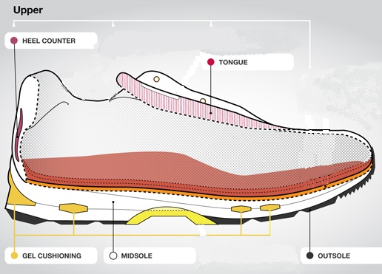
Assessment - 2g: Feet and Footwear
Footwear – Extrinsic factors are not part of the traditional medical examination but critical to assess in patient with falls and near falls
Ask to see shoes they were wearing when they fell (if possible) or at least get a description of the shoes. Look for:
Poor fit (foot moving in shoe)
Lack of support (not laced or buckled)
High heels
Note: some women develop Achilles tendon shortening with chronic high heel use and have difficulty transitioning to lower shoes
Small surface area contact with floor
Smooth slippery sole (lack of functional anti-slip surface by design or if worn out)

Slide 65
Assessment - 2h Environmental hazards
Difficult to assess in the office
Consider referral for in-home OT assessment
Alternatively can ask patient and/or family to gather information via the Home Hazard checklist - Available free through Public Health Agency of Canada
http://www.phac-aspc.gc.ca/seniors-aines/publications/public/injury-blessure/prevent-eviter/index-eng.php

Slide 66
Assessment - 2h: Environmental hazards
Assessment - 2h Environmental hazards
Home hazards (may ask family members to take pictures with smart phones)
Poorly lit stairs, ramps or doorways
Stairs with irregular step width or height
Stairs without handrails or marking on the edges
Slippery floors, throw rugs, loose carpets
Raised sills in door jams
Clutter
Low toilet seats
Lack of grab bars in bathrooms
Poorly maintained or improperly used mobility aids and equipment

Slide 67
2i. Mood and Behavior
Depression can impact on compensatory strategies as well as management of other chronic diseases (e.g. Diabetes, CHF)
Review for risk taking behavior
ETOH use (never hurts to ask again – check with family / caregiver)
Not using mobility aid as prescribed
Standing on ladders / furniture after advised not to

Slide 68
Vertigo - not covered in this module
Refer to Neurology or ENT if
Persistent
CNS finding(s) that cannot be attributed to inner ear (symptoms aside from vertigo, tinnitus, decreased hearing, nausea) suggesting central cause

Slide 69
While assessing and addressing cause(s) of near falls and falls
Consider ordering a Bone Mineral Density if you feel there is a risk of fall occurrence / recurrence and if you feel their life expectancy merits treatment of osteoporosis

Slide 70
Champlain Falls Prevention Strategy:
Stay on Your Feet ® Screening Algorithm
= Community Health Agencies
= Primary Care Providers
= Specialized or Tertiary Care Providers
All adults 65+ should be screened for falls on an annual basis in community programs or with a Primary Care Practitioner. Consider a self-screening tool: “Staying Independent Checklist” *
Screen for fall(s) or near falls:
Two or more falls or near falls in past year
1
Primary Care Assessment/Interventions
Obtain relevant medical history, history of falls, physical examination, including cognitive and functional assessment to identify root cause.
Determine multifactorial fall risk by assessing: (see Guide on reverse) including:
Visual acuity
Other neurological impairments and refer appropriately
Bone health; assess calcium intake & fracture risk; nutritional review. Supplement vitamin D and consider calcium; if ongoing fall risk - consider bone density and treat if OP or history of fragility fractures then treat
Feet and footwear;
Environmental hazards: You Can Prevent Falls (Public Health) at stopfalls.ca
i. Depression & Behavioural Risk Factors ie ETOH.
Fall with injury
Difficulty with walking or balance
Score of 4 or more on Staying Independent Checklist
2
3
Yes to any one of the screening questions?
Obtain fall history
Evaluate gait and use of aids if difficulty or change in walking
Is recurrence of fall likely?
YES
Postural hypotension- • suggest lying and standing BP See www.posturalhypotension.ca
Pills/medication: minimize meds contributing to falls and consider pharmacy consult; optimize pain management
Pain, gait, balance, mobility and muscle strength (ie
NO
Single fall in past year or several near falls?
YES
Evaluate Gait: Abnormalities noted? Yes/No
YES
NO
NO
4
Health Promotion Key Messages:
Encourage regular periodic health visit; annual medication, alcohol review and eye exam
Complete a home safety checklist annually
150 minutes of physical activity per week – consider Champlain Exercise Programs: Champlainhealthline.ca
Muscle and bone strengthening exercises to improve balance
Eat 3 or more servings of calcium rich foods daily
Take a daily vitamin D supplement
REFER
If appropriate, refer to specialized Geriatric services and/ or community programs. See www.rgpeo.com.
See referral and resource list at stopfalls.ca
AGS & BGS Guideline: http://www.americangeriatrics.org/health_care_professionals/clinical_practice/clinical_guidelines_recommendations/prevention_of_falls_summary_of_recommendations/ ;RNAO (2017) Prevention of Fall & Fall Injuries in Older Adults; https://rnao.ca/news/updated-bpg-preventing-falls-and-reducing-injury-falls *Staying Independent Checklist available online at (www.stopfalls.ca ). Health Canada http://hc-sc.gc.ca/fn-an/food-guide-aliment/index-eng.php; Document reviewed / revised 2018

Slide 71
Champlain Falls Prevention Strategy:
Stay on Your Feet ® Screening Algorithm
= Community Health Agencies
= Primary Care Providers
= Specialized or Tertiary Care Providers
All adults 65+ should be screened for falls on an annual basis in community programs or with a Primary Care Practitioner. Consider a self-screening tool: “Staying Independent Checklist” *
Screen for fall(s) or near falls:
Two or more falls or near falls in past year
Primary Care Assessment/Interventions
Obtain relevant medical history, history of falls, physical examination, including cognitive and functional assessment to identify root cause.
Determine multifactorial fall risk by assessing: (see Guide on reverse) including:
Visual acuity
Other neurological impairments and refer appropriately
Bone health; assess calcium intake, fracture risk and nutritional review. Supplement vitamin D. Consider calcium & BMD testing. Treat as per www.osteoporosis.ca guidelines.
Feet and footwear
Environmental hazards: You Can Prevent Falls (Public Health) at www.stopfalls.ca
i. Depression & Behavioural Risk Factors i.e.: ETOH.
Fall with injury
Difficulty with walking or balance
Score of 4 or more on Staying Independent Checklist
1
Postural hypotension - suggest lying and standing BP
(www.posturalhypotension.ca)
Pills/medication: minimize meds contributing to falls and consider pharmacy consult; optimize pain management
Pain, gait, balance, mobility and muscle strength (i.e.: TUG or other tests). Evaluate pain-related mobility: and/or need for mobility aids
Yes to any one of the screening questions?
Obtain fall history
Evaluate gait and use of aids if difficulty or change in walking
Is recurrence of fall likely?
YES
Postural hypotension- • suggest lying and standing BP See www.posturalhypotension.ca
Pills/medication: minimize meds contributing to falls and consider pharmacy consult; optimize pain management
Pain, gait, balance, mobility and muscle strength (ie
NO
2
Single fall in past year or several near falls?
YES
Evaluate Gait: Abnormalities noted? Yes/No
YES
3
NO
NO
4
Health Promotion Key Messages:
Encourage regular periodic health visit; annual medication, alcohol review and eye exam
Complete a home safety checklist annually
150 minutes of physical activity per week – consider Champlain Exercise Programs: Champlainhealthline.ca
Muscle and bone strengthening exercises to improve balance
Eat 3 or more servings of calcium rich foods daily
Take a daily vitamin D supplement
REFER
If appropriate, refer to specialized Geriatric services and/ or community programs. See www.rgpeo.com.
See referral and resource list at stopfalls.ca
AGS & BGS Guideline: http://www.americangeriatrics.org/health_care_professionals/clinical_practice/clinical_guidelines_recommendations/prevention_of_falls_summary_of_recommendations/ ;RNAO (2017) Prevention of Fall & Fall Injuries in Older Adults; https://rnao.ca/news/updated-bpg-preventing-falls-and-reducing-injury-falls *Staying Independent Checklist available online at (www.stopfalls.ca ). Health Canada http://hc-sc.gc.ca/fn-an/food-guide-aliment/index-eng.php; Document reviewed / revised 2018

Slide 72
Staying
Independent
Checklist
Review all
previous
screening
tests

Slide 73
When to refer to Specialized Geriatric Services
If you require assistance with evaluation of fall risk
If you require assistance with treatment
If your patient is falling and has cognitive impairment “Forgetful Fallers”

Slide 74
Where / How to refer
Specialized Geriatric Services (SGS) experts in mobility/falls assessment and treatment.
Geriatric Assessment Outreach Teams (GAOT)
Geriatric Day Hospitals
Champlain (eastern Ontario in or near Ottawa) Region
Geriatric Assessment Outreach Teams (GAOT) at www.rgpeo.com
In other areas of Ontario
Regional Geriatric Programs (RGPs) of Ontario www.rgps.on.ca
Select Health Care Practitioners – RGPEO Specialized Geriatric Services – in the Community (Outpatient) www.rgpeo.com/en/health-care-practitioners/rgpeo-specialized-geriatric-services/in-the-community-(out-patient).aspx
Areas where RGPs are not available – search falls, geriatrics, city

Slide 75
Learn more
stopfalls.ca
geriatricsjournal.ca
POSTURALHYPOTENSION.CA

